Slide 1
Internet Programming
Cascading Style Sheet

Slide 2
CSS
CSS is an acronym for Cascading Style Sheets.
CSS is a style language that defines layout of HTML documents
CSS covers fonts, colours, margins, lines, height, width, background images, advanced positions
control the style and layout of multiple Web pages all at once.

Slide 3
CSS
HTML can be (mis-)used to add layout to websites.
But CSS offers more options and is more accurate and sophisticated.
CSS is supported by all browsers today.

Slide 4
CSS and HTML
HTML is used to structure content.
CSS is used for formatting structured content.
Many new layout tags such as <blink> were only supported by one type of browser.
"You need browser X to view this page" became a common disclaimer on web sites.

Slide 5
CSS and HTML
CSS was invented to remedy this situation by providing web designers with sophisticated layout opportunities
Separation of the presentation style of documents from the content of documents, makes site maintenance a lot easier. ported by all browsers.

Slide 6
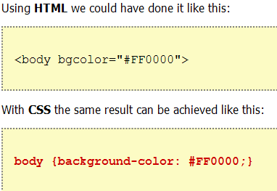
CSS and HTML

Slide 7
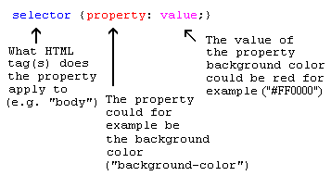
CSS format

Slide 8
CSS how to…
There are three ways of inserting a style sheet:
Inline style sheet
Internal style sheet
External style

Slide 9
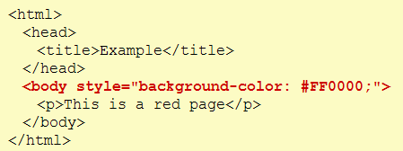
CSS to HTML: Attribute Style
Called inline CSS.

Slide 10
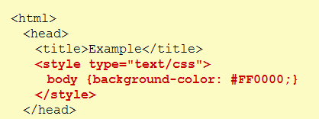
CSS to HTML: Tag Style
Called internal CSS.

Slide 11
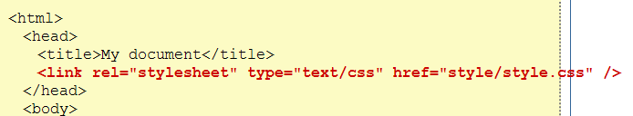
CSS to HTML: Link Style
rel = relation= Specifies the relationship between the current document and the linked document
Called External CSS.

Slide 12
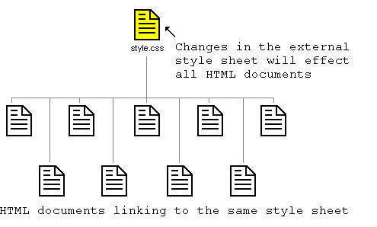
Benefit

Slide 13
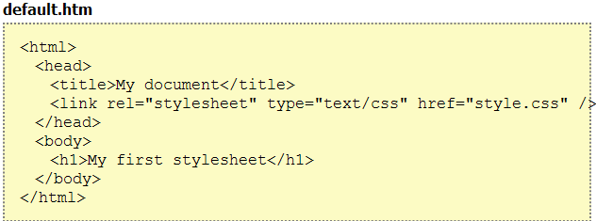
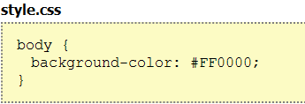
Try it yourself

Slide 14
Try it yourself
.css file
body{ background-color:#d0e4fe; } h1{ color:orange; text-align:center; } p{ font-family:"Times New Roman"; font-size:20px; }
a:link {color:#FF0000;} /* unvisited link */
a:visited {color:#00FF00;} /* visited link */
a:hover {color:#FF00FF;} /* mouse over link */
a:active {color:#0000FF;} /* selected link */

Slide 15
CSS ID
<html>
<head>
<style type="text/css">
#para1
{text-align:center;
color:red;
}
</style>
</head>
<body>
<p id="para1">Hello World!</p>
<p>This paragraph is not affected by the style.</p>
</body>
</html>
See css_id.html
CSS allows you to specify your own selectors called "id" and "class".
The id Selector
The id selector is used to specify a style for a single, unique element.
The id selector uses the id attribute of the HTML element, and is defined with a "#".
Do NOT start an ID name with a number! It will not work in Mozilla/Firefox.

Slide 16
CSS Class
<html>
<head>
<style type="text/css">
.center
{
text-align:center;
}
</style>
</head>
<body>
<h1 class="center">Center-aligned heading</h1>
<p class="center">Center-aligned paragraph.</p>
</body>
</html>
See css_class.html
The class Selector
The class selector is used to specify a style for a group of elements. Unlike the id selector, the class selector is most often used on several elements.
This allows you to set a particular style for many HTML elements with the same class.
The class selector uses the HTML class attribute, and is defined with a ".“

Slide 17
CSS Class
<html>
<head>
<style type="text/css">
p.center
{
text-align:center;
}
</style>
</head>
<body>
<h1 class="center">This heading will not be affected</h1>
<p class="center">This paragraph will be center-aligned.</p>
</body>
</html>
See css_sp_class.html
The class Selector
You can also specify that only specific HTML elements should be affected by a class.

